Slide 1
555 Timer

Slide 2
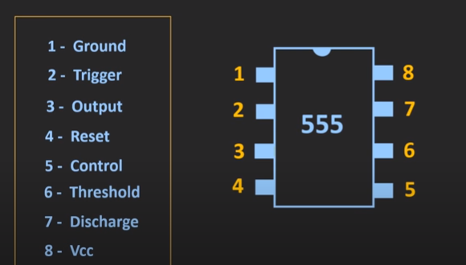
Pin Diagram

Slide 3
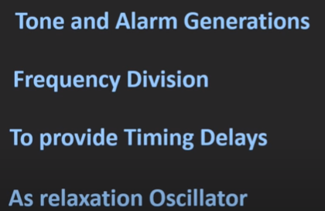
Applications

Slide 4
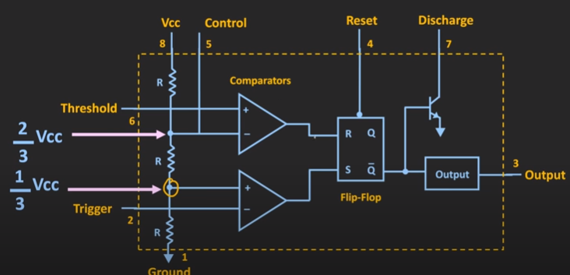

Block diagram of 555 Timer

Slide 5
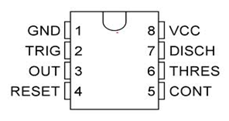
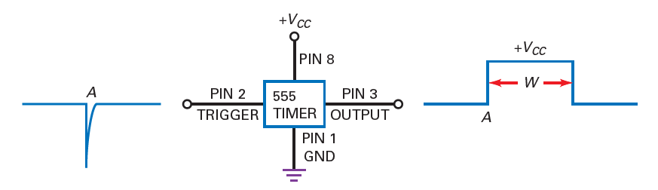
555 timer IC
Monostable multivibrator - one stable state
Astable multivibrator – no stable state
Lecture 34

Slide 6
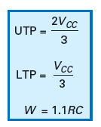
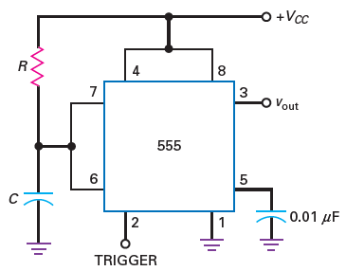
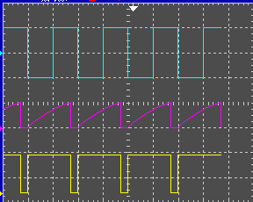
Mono-stable multivibrator
Trg
C
Monostable multivibrator
Vout
Lecture 34

Slide 7
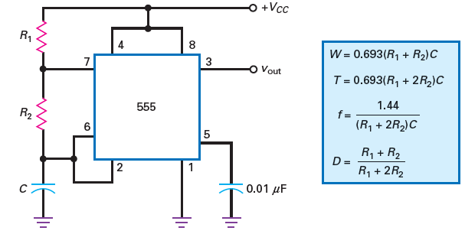
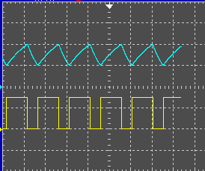
Astable multivibrator
C
Astable multivibrator
Vout
Lecture 34

Slide 8
Thank You

